Slide 1
Fiber Degradation in the Rumen
Aaron Stalker Range Cow Nutrition Specialist UNL / WCREC – North Platte
Notes:
This Powerpoint presentation was created with the express purpose of being used in conjunction with the mobile beef laboratory. Please do not provide copies, in whole or in part, to anyone not participating in a mobile beef laboratory activity or otherwise distribute or disseminate this presentation.

Slide 2
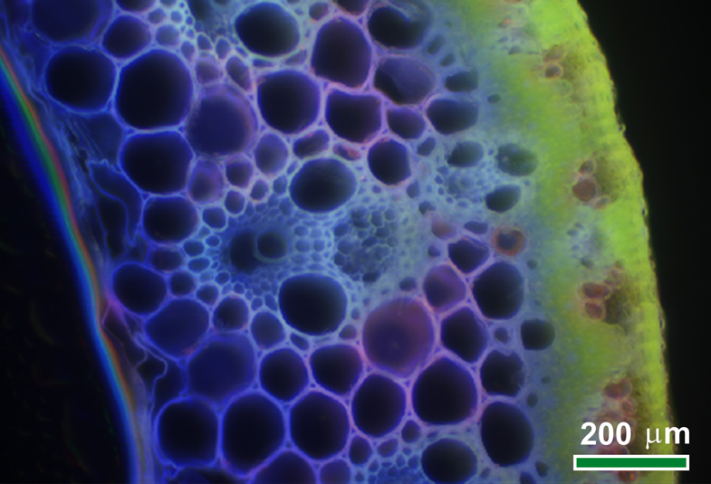
Notes:
This is part of a cross-section of a switchgrass stem at micrometer scale. Autofluorescent signals from compounds in the stem show less lignin and more sunlight-absorbing chlorophyll in the green outer layer on the right. Deeper blue areas toward the stem’s center show more highly lignified xylem tissue used for water and nutrient transport.
Credit or Source :
BESC researcher Shi-You Ding, National Renewable Energy Laboratory
U.S. Department of Energy, Genome Programs, http://genomics.energy.gov.

Slide 3
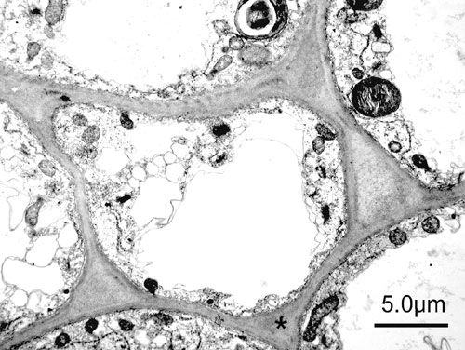
Notes:
This is a close up of a plant cell. You can tell it’s a plant cell because of the cell wall.
Plants have thick, rigid cell walls which provide structure.

Slide 4
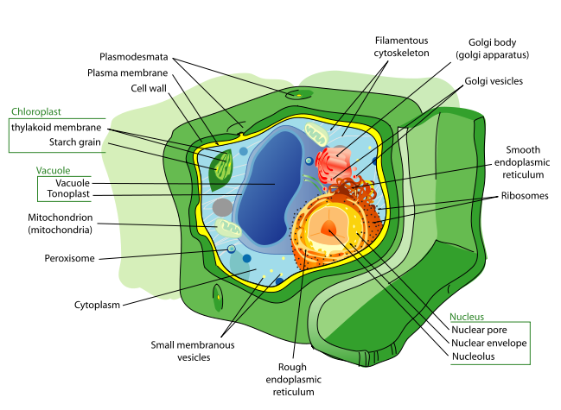
Notes:
This is a three dimensional image of a plant cell.

Slide 5
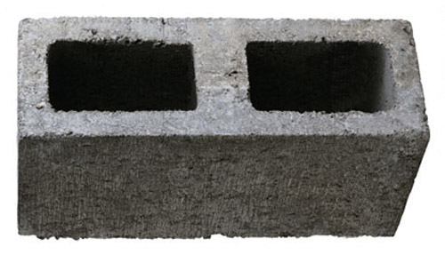
Notes:
Plant cells function much like concrete masonry units (aka cinder blocks) where cells lower down support the cells above. This is possible because of the structural carbohydrates found plant cell walls.

Slide 6
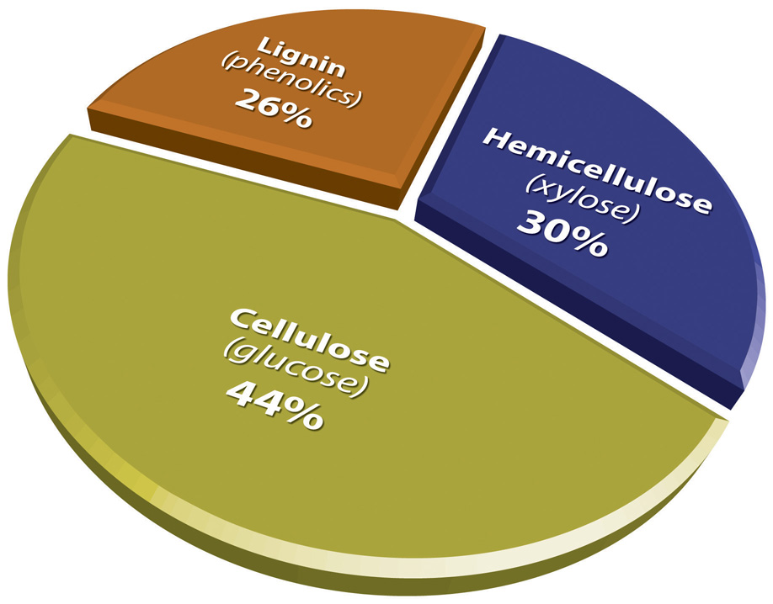
Notes:
Approximate distribution of the three primary components of plant cell walls
For your information:
Cellulose microfibrils are embedded within a matrix of other polymers (hemicellulose and lignin). Hemicellulose, a mix of branched polysaccharides made up of both five- and six-carbon sugars, links to a rigid noncarbohydrate polymer called lignin, which forms a protective coating to shield cellulose and hemicellulose from enzymatic attack.
Credit or Source : Genome Management Information System, Oak Ridge National Laboratory
U.S. Department of Energy Genome Programs and the website http://genomics.energy.gov.

Slide 7
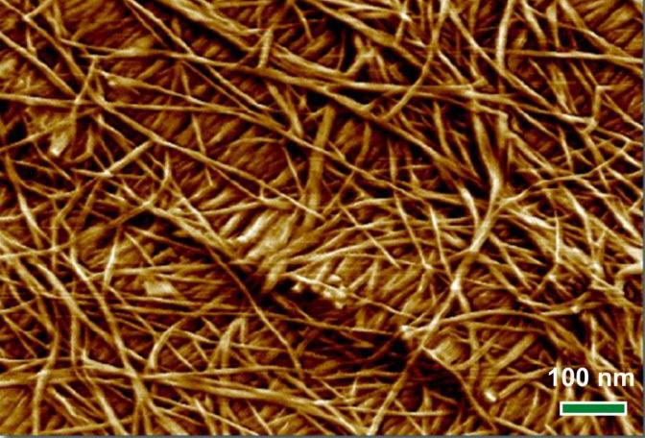
Notes:
This is an atomic force micrograph showing nanometer-scale detail of the interwoven mesh of lignocellulosic microfibril bundles in a switchgrass cell wall.
Source: U.S. Department of Energy, Genome Programs, http://genomics.energy.gov.

Slide 8
Notes:
Cellulose fibers are made up of bundles of cellulose chains organized into microfibrils which are organized into macrofibrils.

Slide 9
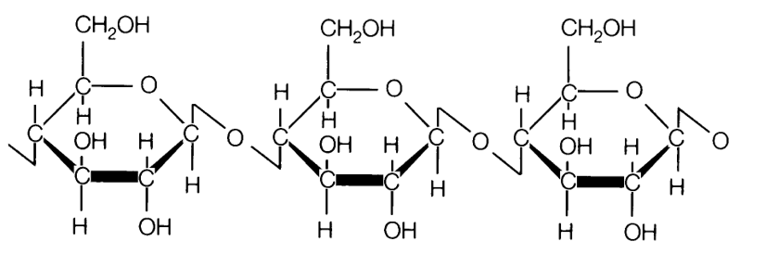
Notes:
Cellulose is the most abundant biological material on the planet and consists of tightly bound sugar chains organized into strong cable-like structures called microfibrils. Microfibrils of cellulose reinforce plant cell walls, giving them their structure. Cellulose chains are comprised of thousands of molecules of glucose, a six-carbon sugar commonly called “blood sugar”. Cellulose is chemically similar to starch and glycogen.

Slide 10
Notes:
This is the chemical structure of glycogen and also starch. The only difference between cellulose and glycogen/starch is the way adjacent glucose molecules are bound to each other. In starch, adjacent glucose molecules are linked by what’s called an alpha bond. Alpha bonds are easily broken. In cellulose, adjacent glucose molecules are linked by what’s called a beta bond. Beta bonds are very strong and require a special enzyme called cellulase to break them. Mammals do not make cellulase.

Slide 11
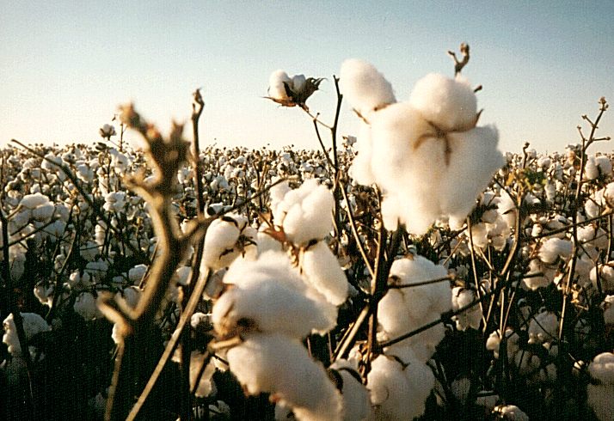
Notes:
Cotton is comprised of pure cellulose

Slide 12
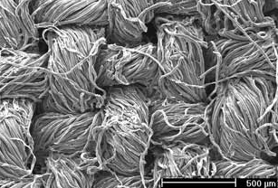
Notes:
This is what a piece of cotton cloth looks like under a microscope. Thread is made up of macrofibrils of cellulose.

Slide 13
Notes:
Review: Cellulose is the major component of plant cell walls. Cellulose is made up of glucose molecules held together by a very strong “beta” bond that is broken by cellulase.
Cellulase is a complex enzyme and is not produced by mammals.
Credit or Source : Genome Management Information System, Oak Ridge National Laboratory
U.S. Department of Energy Genome Programs and the website http://genomics.energy.gov.

Slide 14
Notes:
There are almost 23 million acres of rangeland in Nebraska (that’s more than 46% of the total area of NE). In essence, everything that’s not green, black or blue in this image is rangeland. If it weren’t for ruminants and the microorganisms in their digestive tract this land could not be use to produce food because it is poorly suited to crop production.

Slide 15
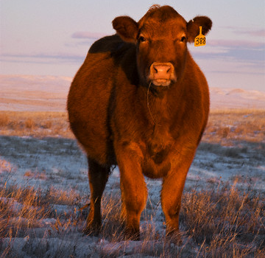
Notes:
What would happen if a person ate nothing but the grass in this picture? They would quickly starve to death. Why? Because this grass is mostly cellulose and mammals don’t make cellulase, the enzyme that breaks down cellusoe.
But what happens when a cow eats nothing but the grass in this picture? It survives. But we already said the majority of what this cow’s eating is cellulose and mammals don’t make cellulase. How can she survive?

Slide 16
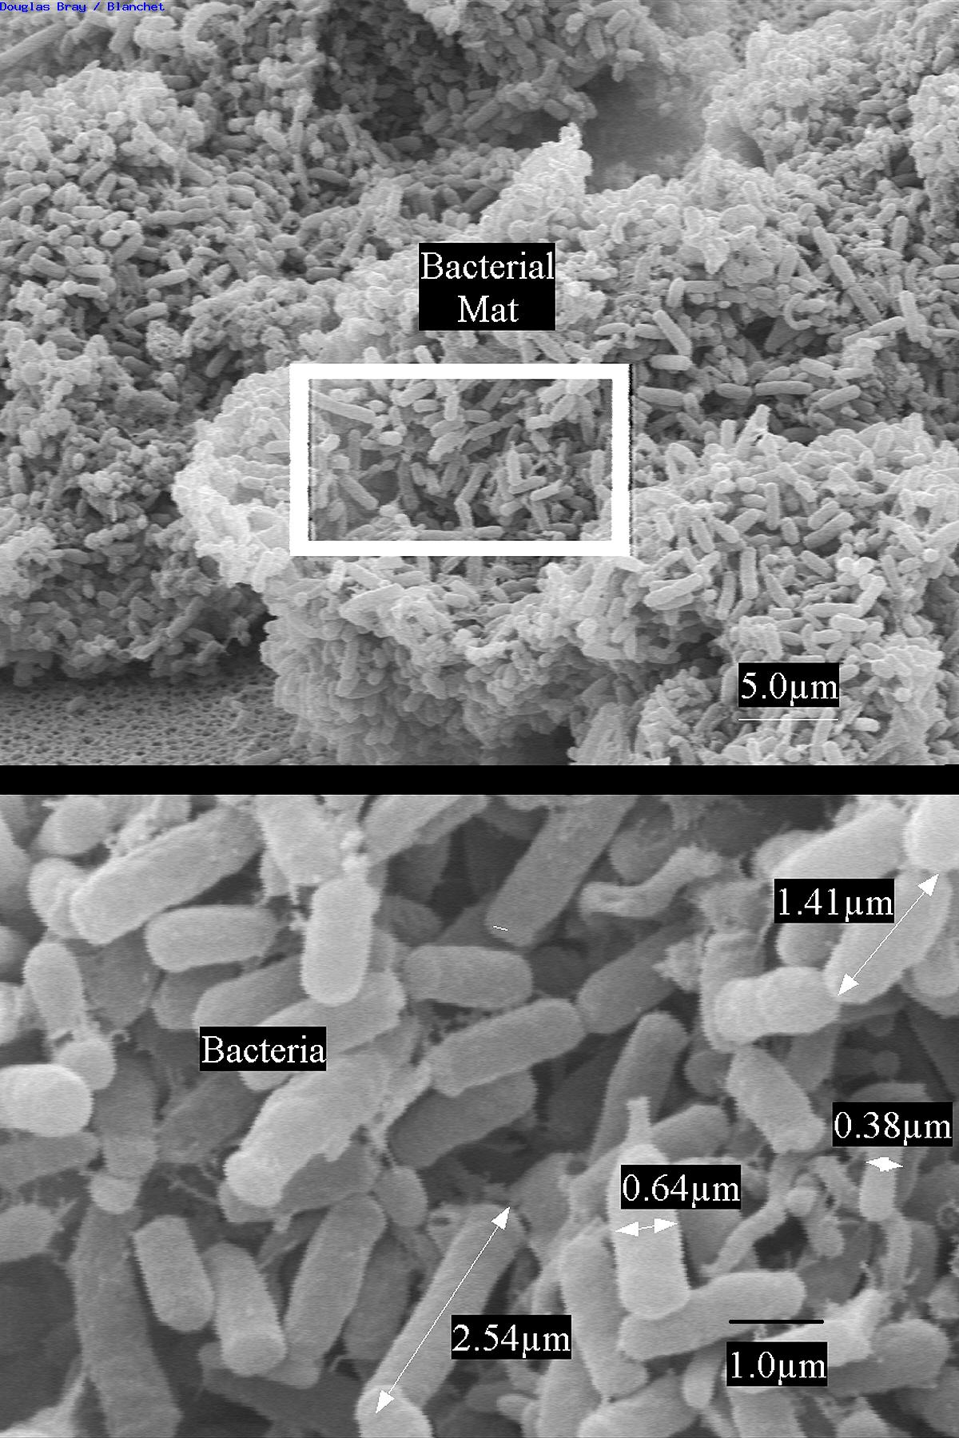
Notes:
The reason a cow can not just survive but grow big and fat on grass is because she has a specialized stomach called a rumen where trillions of bacteria/archea grow. Bacteria are very small yet certain species produce cellulase, allowing them to break down cellulose. The cow provides the perfect environment for bacterial able to breakdown cellulose (called cellulolytic bacteria) to grow. There are about 200 different species of bacteria/archea that grow inside a cow’s rumen. In each milliliter (mL) of ruminal fluid there are 10-50 billion bacterial/archeal cells. The amount of bacteria depend on several factors, the most important of which is diet, but researchers estimate there are a total of about 140 trillion bacteria inside a cow’s stomach. Let’s put that into perspective.

Slide 17
Notes:
One hundred $100 bills or $10,000

Slide 18
Notes:
$1 million =$1,000,000 or 100 packets of $10,000

Slide 19
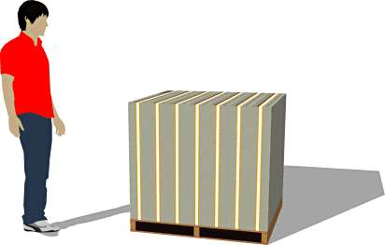
Notes:
$1 hundred million = $100,000,000

Slide 20
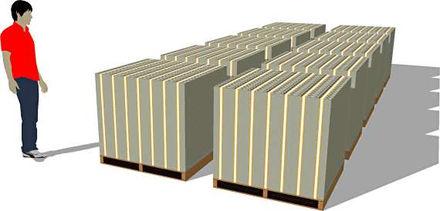
Notes:
$1 billion =$1,000,000,000

Slide 21
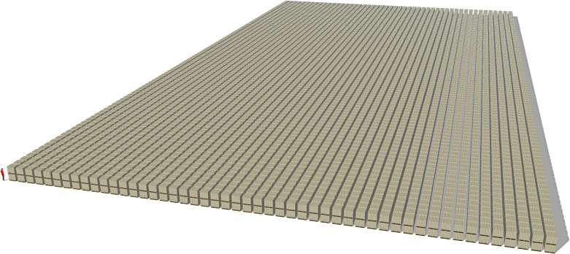
Notes:
This is what $1 trillion worth of $100 bills looks like.

Slide 22
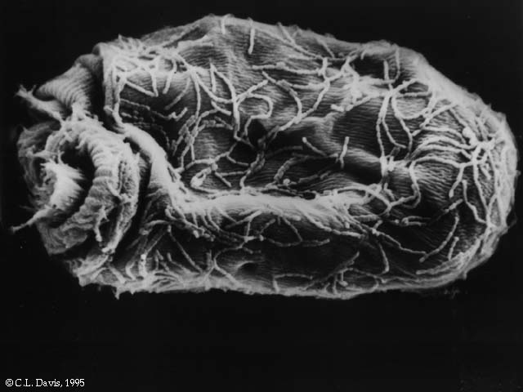
Notes:
Bacteria and archea are not the only microorganisms found in the rumen. There are also many different species of protozoa. Protozoa numbers are not nearly as numerous as bacteria/archea but they are much larger in size. In one mL of rumen fluid there can be as many as 1 million protozoan.

Slide 23
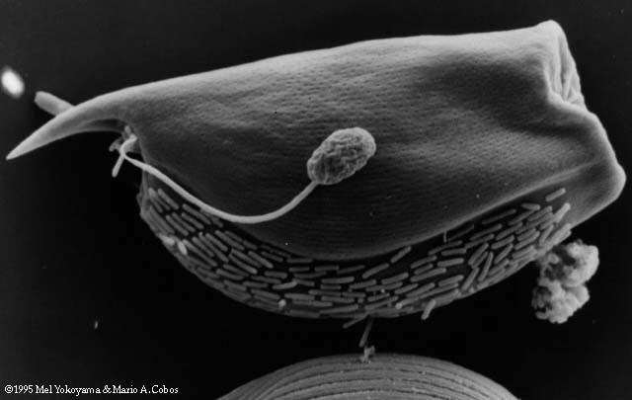
Notes:
Fungi are also found in the rumen. This micrograph shows all three catergories of microorganisms found in the rumen, Bacteria/Archea, Protozoa and Fungi.

Slide 24
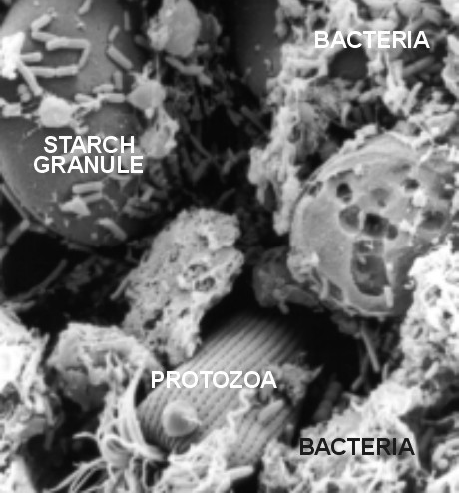
Notes:
The role of the microorganisms is to break down the plant tissue consumed by the cow into something the cow can use.

Slide 25
Extension is a Division of the Institute of Agriculture and Natural Resources at the University of Nebraska–Lincoln cooperating with the Counties and the United States Department of Agriculture.
University of Nebraska–Lincoln Extension educational programs abide with the nondiscrimination policies of the University of Nebraska–Lincoln and the United States Department of Agriculture.

